Slide 1
Test Driven Development & UNIt TESTING

Slide 2
Outline
Outline
What is TDD
Code Refactoring
Steps to start TDD
Unit Testing
Code Coverage

Slide 3
What is TDD
Test-Driven Development (TDD) is a software development technique that involves (repeatedly) first writing a test case and then implementing the code necessary to exercise the test
(Test case First, Then Code)
In TDD:
Requirements => Tests => Code
Requirements drive the tests (user stories/use cases)
Tests drive the development of the application code
No application code is written without writing a failing test first
Tests are collected in a suite and the suite is run frequently (e.g. on check in)
Tests and code are written in elementary increments
Refactoring is a continuous operation

Slide 4
What is TDD
The developer writes an (initially failing) automated test case that defines a desired requirement (improvement or new function) .
The developer then produces the minimum amount of code to pass that test
and finally re-factors the new code to acceptable standards
Notes:
Add a Test + ensure it fails
Write minimum amout of code to get it to pass
Refactor code, all the while rerunning tests

Slide 5
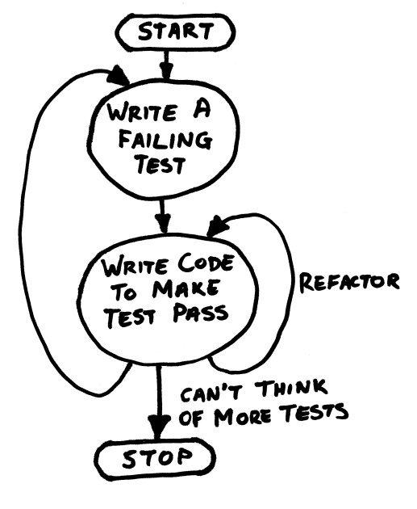
What is TDD
Test should Initially Fail (and for expected reason)
TDD = Test First Development + Refactoring
Add a Test + ensure it fails
Write minimum amount of code to get it to pass
Refractor code

Slide 6
Code Refactoring
Refactoring is a disciplined technique for restructuring an existing body of code, altering its internal structure without changing its external behaviour.
Code Improvement
Refactoring removes ‘code smell’ – check code metrics
Aim for “clean code”

Slide 7
TDD Steps
Analyze the requirements + write the list of tasks or features
Pick a task or feature:
Brainstorm a list of tests for the task or feature
Review the tests list and pick a test
Write the test case
Write only enough code that the test case compiles
Run the test and see running the code fails
Write only enough code to just pass the test
Re-factor the production code
Repeat

Slide 8
Unit Tests
Testing a method (unit) in a class you are writing – while you are writing that class
A type of white box test
Tests are written by a developer

Slide 9
Unit Test - Definitions
Test Fixture/Test Class – A class with some unit tests in it.
Test (or Test Method) – a test implemented in a Test Class
Test Suite - A set of test grouped together
Test Harness/ Runner – The tool that actually executes the tests.

Slide 10
Microsoft Unit Testing Framework
Microsoft.VisualStudio.TestTools.UnitTesting namespace
A unit test = a method which is public and void with no arguments which has attribute [TestMethod] in a class with attribute [TestClass]
A unit test passes or fails
3 ways to verify a unit test has passed:
Using an assert (validate a specific outcome) (e.g. Assert.AreEqual(…))- if any assert in the unit test is false the test fails
Verify that a specific exception has been thrown (using [ExpectedException..) – if the exception is not thrown by the test the test fails
Verify that no exception has been thrown – an exception thrown by a test which is not expected results in the test failing
An AssertFailedException is thrown by the framework when a test fails

Slide 11
Microsoft Unit Testing Framework
Assertion classes:
Assert (general purpose assertions)
AreEqual, AreSame, IsTrue, IsNull and opposites like AreNotEqual etc.
CollectionAssert (special assertions for collections)
AreEqual, AreNotEqual, AreEquivalent., IsSubsetOf, Contains, and opposites etc.
StringAssert (special assertions for strings)
Contains, EndsWith, Matches, StartsWith, and opposites etc.

Slide 12
Code Coverage
Code Coverage is an approach or technique that sees you executing [all] the statements and paths through your code-base
Which code has been touched by a test.
Identifies code that your tests missed
Thus, you should find bugs you may not otherwise have found, code coverage “gives you clues”
Identifies code that does not have a test case exercising it
Code coverage can be a useful metric, but it must be used with care
Determine whether high code coverage is a good thing
Simply “touching” every line of code might not be suitable

